Slide 1

Bacchus Project’s Progress

Slide 2



Last Meeting Result
Design
Need a new design, color combos, choice of picture
Need to learn Adobe InDesign
Content
Need to rearrange the content list
Need to fill up the content
Data
Need to find quantitative data
Need new links for further study

Slide 3



Design
Change of Logo
Change of Color Combos
Change of Pictures and learn how to use InDesign

Slide 4
Content
Report Overview
Why Insect
Short overview of the insect industry today
Key drivers to grow the insect industry
 | Acceptance among western people to eat insect
 | Legislative security
 | Production cost barrier
 | Focus on mealworms
 |  | Presentation
 |  | Academic research in insect nutritional properties
 |  | Academic research in ecological impact
Mealworm flour as a solution
Norms

Slide 5
Content
 | Acceptance of mealworm flour
 | Health issues in mealworm flour
Law
 | Current legislation in the main market for mealworm flour
 | Prospect on legislation for mealworm flour
Technology
 | Current processes in insect industry / standardization & industrialization
 | Potential technologies for insect industry
 | Our own production improvement Solution
Market
 | Impact assessment of mealworm flour
 | A competitive analysis of mealworm flour (5 Porter)
Conclusion

Slide 6
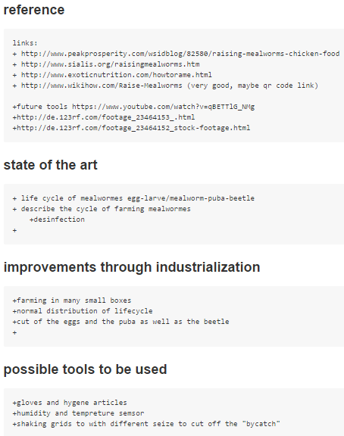
Data
Any other links
Health issue in consuming insect
Safe insect production
First industrial scale insect production plant in Belgium
A company making fast food snacks of insect
In the Belgian supermarket of carrefour and delhaize are products with insects inside sold since end of 2014
The company producing the insect sold in carrefour
All university partners involved in upscaling of insects for human consumption in Belgium
French agency of food also published about edible insect (recently)

